Slide 1
Sentiment Analysis Project
Using Azure and Python for Data Ingestion and Visualization
By:-
Krima Patel – 200596917
Pratham Patel -- 200599195

Slide 2
Introduction
Sentiment analysis uses NLP to identify positive, negative, or neutral sentiments in text.
Applications:
- Social media monitoring
- Customer feedback analysis
- Market research
Tools Used:
- Azure Data Factory
- Azure SQL Database
- Python (TextBlob library)
- Power BI for visualization

Slide 3
Project Architecture
Overview of the architecture:
1. Data Collection: Scraping data.
2. Data Ingestion: Using Azure Blob Storage and Azure Data Factory.
3. Data Storage: Loading data into Azure SQL Database.
4. Visualization: Creating dashboards in Power BI.
Flow Diagram:
Scraping → Blob Storage → Azure Data Factory → Azure SQL → Power BI

Slide 4
Workflow Steps
1. Collection:
Python script scrapes data and saves it as a CSV file.
2. Ingestion:
CSV is uploaded to Azure Blob Storage.
Azure Data Factory automates data transfer to Azure SQL Database.
3. Processing:
Data is processed with Python and TextBlob to calculate sentiment polarity.
4. Visualization:
Power BI connects to Azure SQL Database to create visual dashboards.

Slide 5
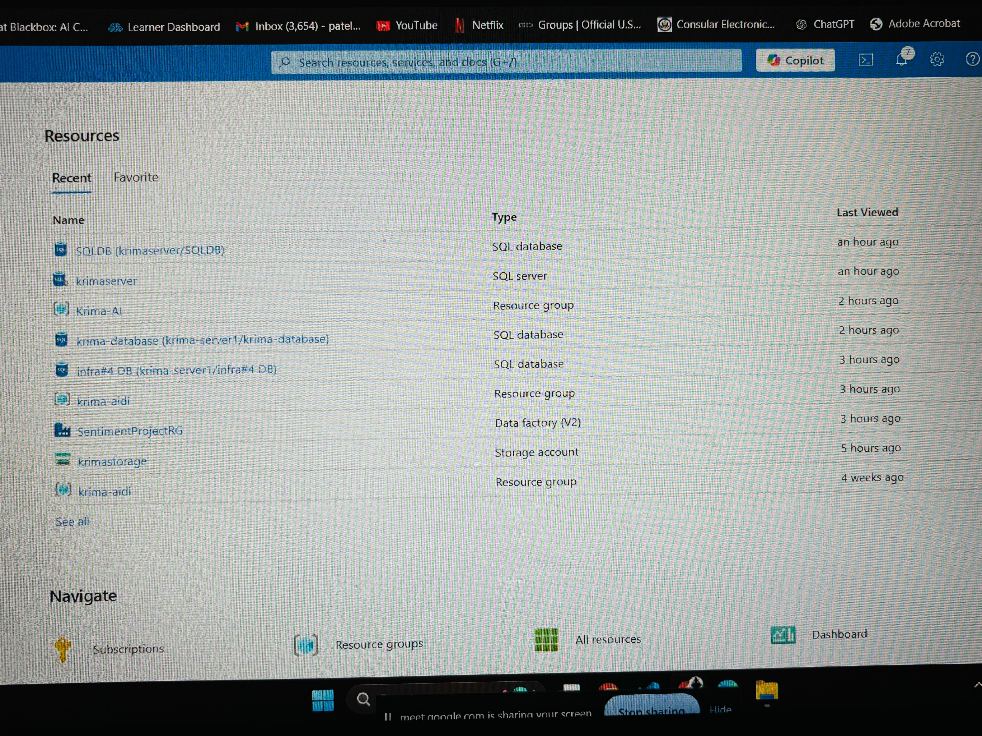
Azure dashboard

Slide 6
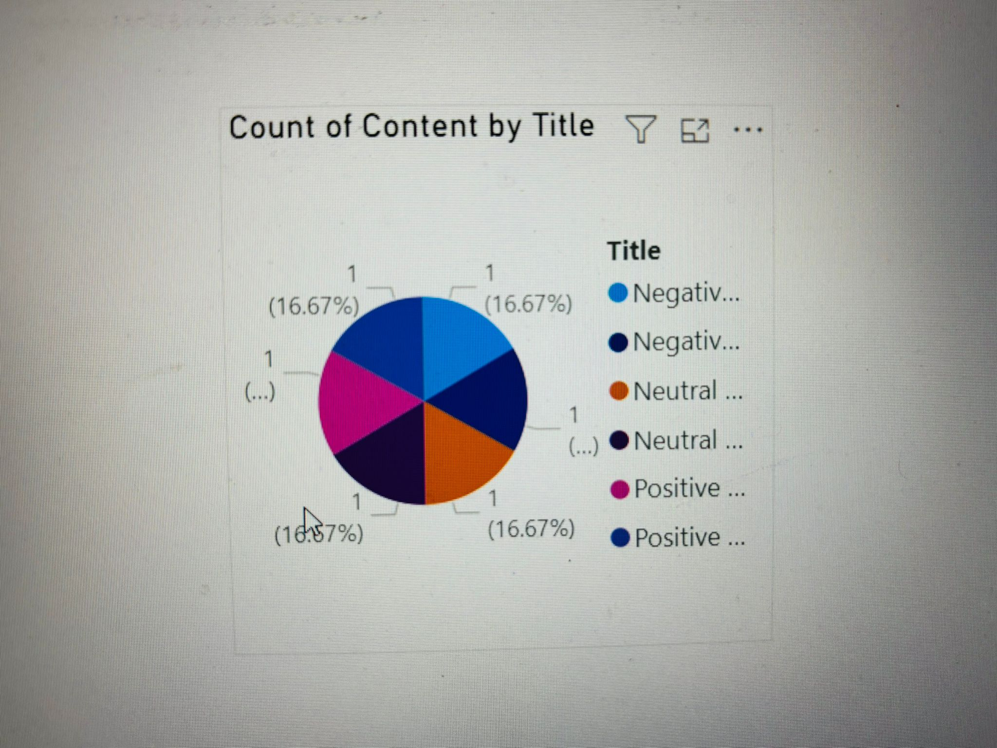
Pie chart

Slide 7
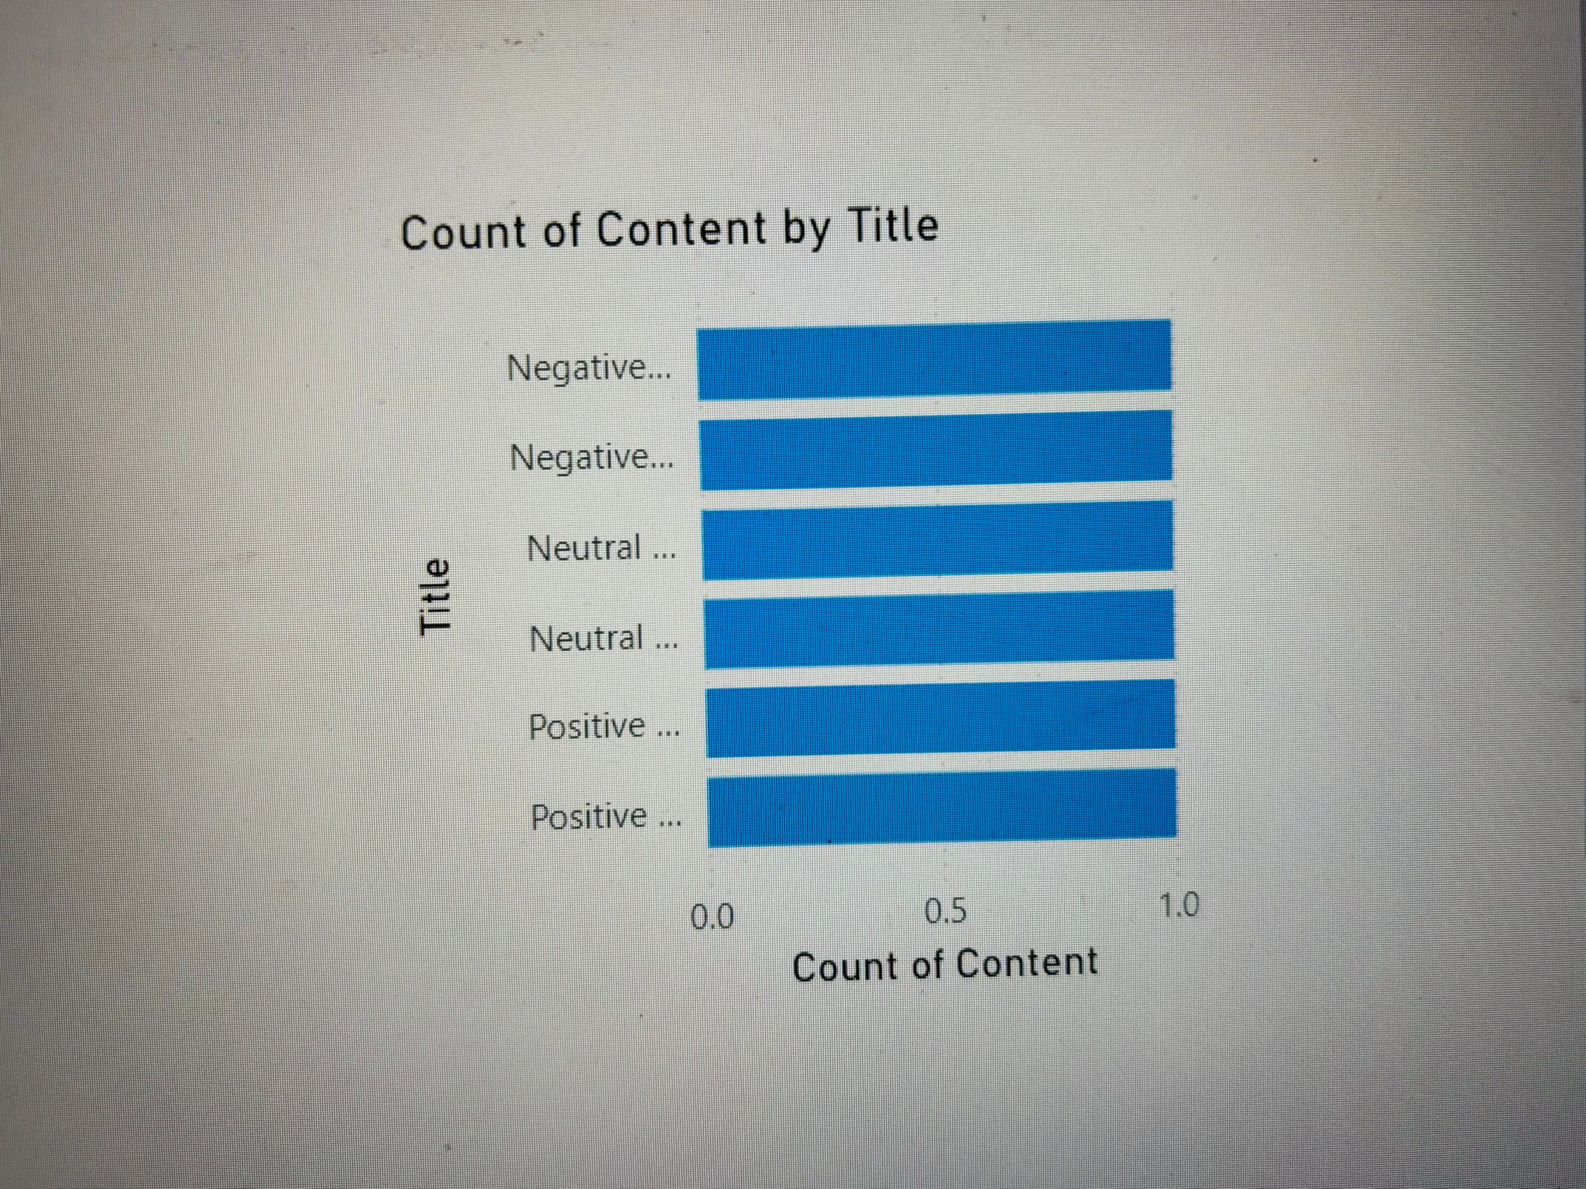
Stacked bar chart

Slide 8
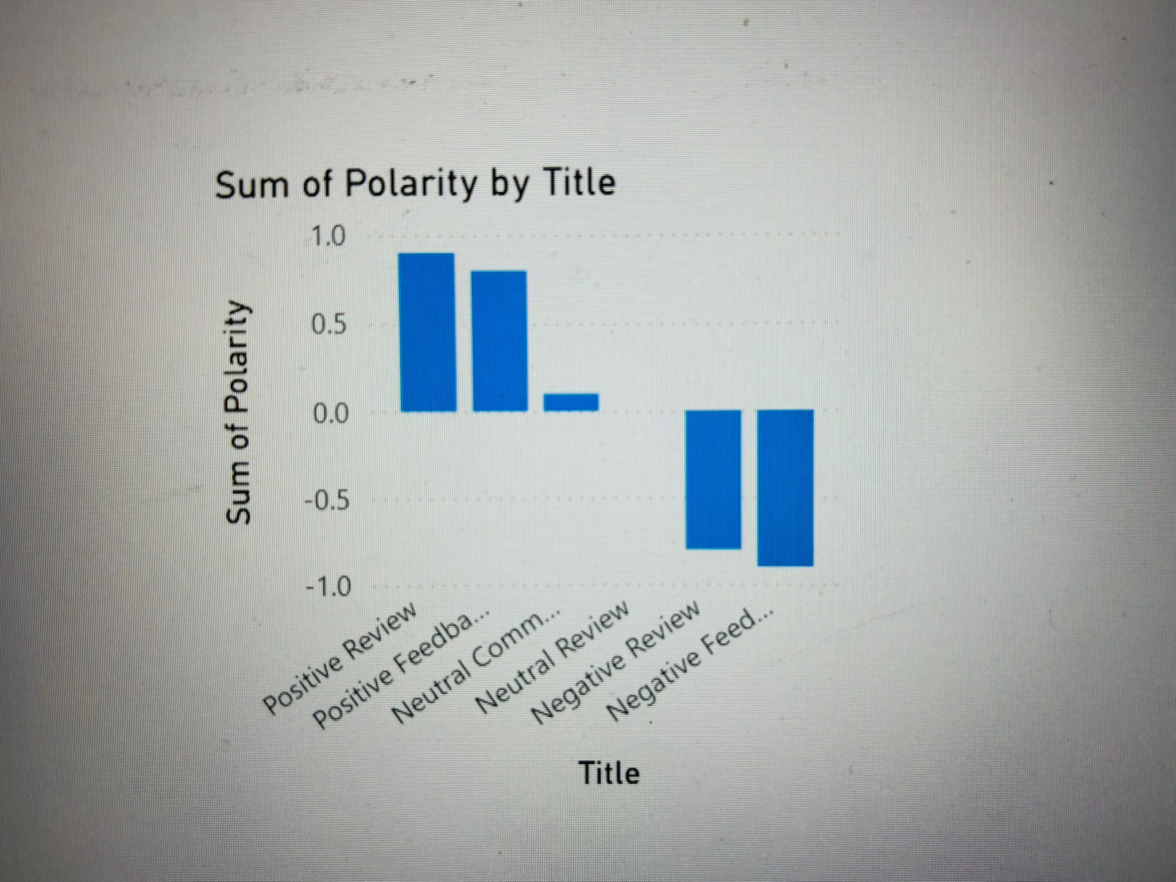
Stacked column chart

Slide 9
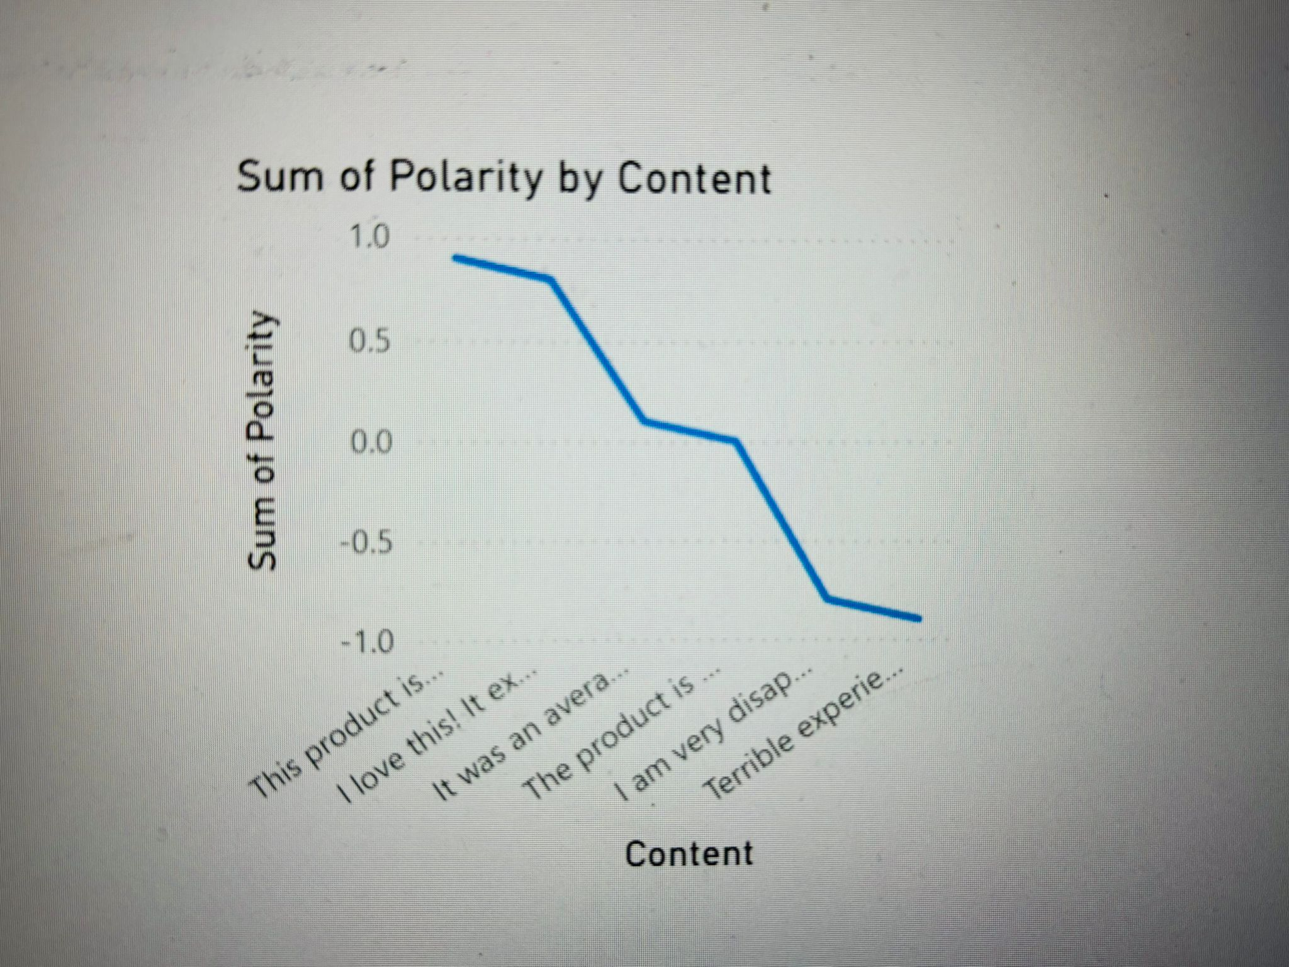
Line chart

Slide 10
Tools and Challenges
Tools Used:
- Azure (Blob Storage, Data Factory, SQL Database)
- Python (TextBlob for sentiment analysis)
- Power BI for dashboards
Challenges:
- Setting up Azure Data Factory pipelines.
- Configuring Power BI to connect to Azure SQL Database.
- Interpreting sentiment polarity scores.

Slide 11
Conclusion
Summary:
Demonstrated how sentiment analysis can provide actionable insights.
Created automated data ingestion and visualization workflows.
Future Scope:
Apply real-time sentiment analysis with Azure Stream Analytics.
Extend analysis to multiple languages using advanced NLP models.

Slide 12
Github link
Link :- https://github.com/PrathamPatel232/Sentiment-Analysis-Project

